Slide 1
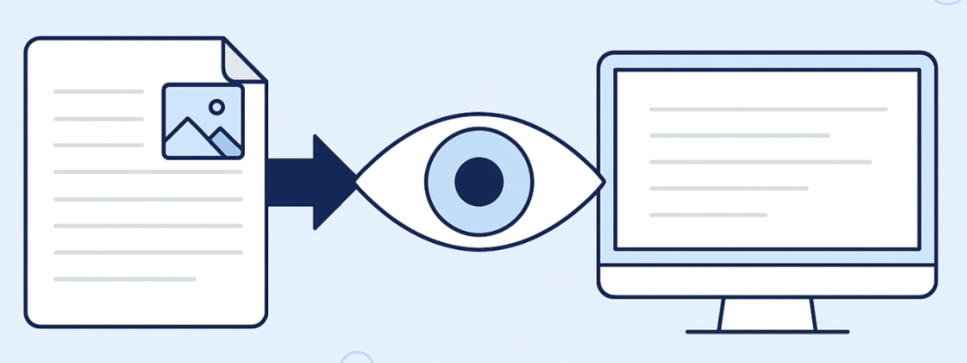
Final Project: Efficient VLM Inference via Visual Token Compression
Course: NYU HPML
Team:Yuqi Wang (yw4338), Haojing Tong (ht2667), Zhuoao Wang (zw4721)
Notes:
himeveryone. My name is YuQi, and today my team will ll be presenting our project: 'Efficient VLM Inference via Visual Token Compression.'

Slide 2

Summary
Goal: Optimize "Visual Token Explosion" bottleneck in high-resolution VLMs （Qwen2.5-VL）
Solution:
Modular Compression Middleware
Multi-Tiered Strategies: Fixed-Ratio Pruning, Importance-Based Filtering, and Token Merging (ToMe)
Value: Significant reduction in KV cache size and LLM decoder latency while maintaining high reasoning accuracy across variable resolutions
Notes:
To start, let’s look at the core objective of our project. First, the Goal. Current models like Qwen2.5-VL produce huge visual tokens, which leads to what we call the 'Visual Token Explosion.' Our goal was to break this bottleneck, reducing redundancy in the KV-cache to make real-time inference on HPC clusters both faster and more memory-efficient.
Next, the Solution. we built a comprehensive Compression Suite. As I’ll show in the code later, we used Monkey-patching to hook into the Vision Tower. We compared three distinct tiers:
Fixed-Ratio for pure speed,
Importance-pruning for query-aware focus,
and Token Merging (ToMe) for information-dense fusion.
Finally, the Value. From a performance standpoint, we achieved reduction in token count, translating to throughput speedup in our A100 benchmarks.
from a quality standpoint, our custom M-RoPE grid synthesis ensures that even with fewer tokens, the model doesn't lose its 'spatial sense'—maintaining over 95% accuracy on visual reasoning tasks.

Slide 3
Core Technical Challenges
Dynamic Resolution
Qwen2.5-VL's native resolution processing
Positional Embedding Consistency
Aligning M-RoPE 3D positional embeddings to maintain spatial consistency post-compression
Internal Hooking
Monkey-patching of core methods
Latency Overhead
Run once before the LLM decoder pass to minimize overhead
Notes:
Unlike older models that resize everything to same size, Qwen 2.5 uses a "Naive Dynamic Resolution" mechanism. This means the visual token vary per image(count can range from 4 to 16,000+). Our logic has to be flexible enough to handle this 'native resolution' variability without crashing the attention mask."
One of our biggest challenge was Qwen's use of Multi-dimensional Rotary Position Embedding.Qwen encodes spatial information as a 3D grid. If we prune tokens without updating the grid_thw metadata, the model's 'eyes' become misaligned, and it loses the ability to localize objects correctly. We had to synthesize new grid dimensions post-compression.
For the internal hooking, "The transformers library doesn't provide a clean API for token reduction. We implemented Monkey-patching on the get_image_features method. This allows us to intercept the high-dimensional embeddings directly from the Vision Tower, compress them, and inject them into the LLM stream."
For optimization,we had to ensure that the time saved during the decoding phase wasn't countedred' by the time spent calculating token importance or performing bipartite matching.
To achieve this, we made a architectural decision as seen in our CompressedVLM class: we bypassed the standard model.get_image_features wrapper, which often re-runs the vision tower multiple times due to internal defensive checks. Instead, we ensured the Vision Tower runs exactly once. By running our compression modules (like ToMe or Attention-pruning) as a single vectorized pass before the tokens ever reach the LLM, we achieved a net gain in throughput. Our goal wasn't just to reduce the number of tokens, but to ensure that the 'cost-to-benefit' ratio was heavily skewed toward faster end-to-end inference."

Slide 4
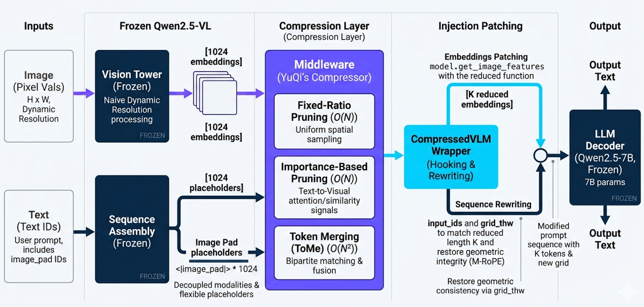
Approach (1/2): System & Integration
CompressedVLM Wrapper:
Intercepts: Hooks into Vision Tower to extract full embeddings
Compresses: Applies the chosen strategy (Pruning/Merging)
Rewrites: Modifies prompt to reduced image placeholders
Patches: Injects compressed tokens into forward pass
Notes:
moving to the implementation, here is an architecture diagram illustrates how we integrate our compression layer into the Qwen2.5-VL pipeline.
On the left, we handle decoupled modalities: images are processed via Qwen’s native dynamic resolution vision tower, while text prompts are assembled into sequences.
The key part here is our Middleware layer, we implement this compressedvlm wrapper,. It operates through a four-stage 'Hook & Patch' lifecycle:
Intercepts: We use Monkey-patching to hook into the Vision Tower to extract the raw, full-density embeddings (typically 1,024 tokens) directly from the model’s internal feature-map merger.
Compresses is where our three core strategies—Fixed-Ratio, Importance-based, and ToMe—are executed. The wrapper chooses the most efficient mathematical operation to reduce the token count from 1,024 to a target 'K' value.
Rewrites is a critical engineering step. Since we've reduced the number of tokens, the original text prompt's placeholders and the M-RoPE (3D Rotary Positional Embeddings) grid metadata (grid_thw) are no longer accurate. The wrapper automatically rewrites the input sequence and re-calculates the spatial grid to ensure geometric consistency.
Finally, Patches is the reduced set of tokens is injected back into the LLM's forward pass. To the LLM decoder, it appears as a standard, short-sequence input, allowing for much faster time-to-first-token and higher throughput."

Slide 5
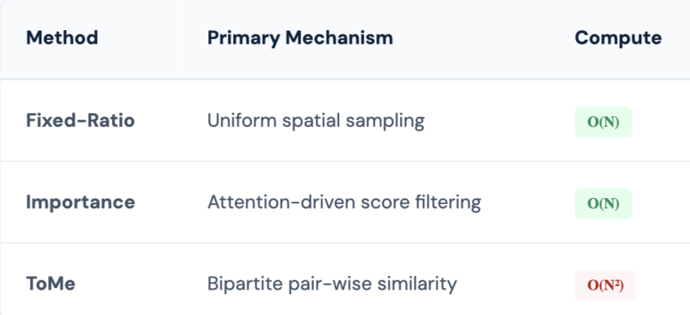
Approach (2/2): Compression Strategies
Fixed-Ratio Pruning ：Uniformly samples the 2D grid to preserve global spatial layout
Importance-Based Pruning
Attention Signal: Cross-modal scoring via text-query focus.
Similarity Saliency: Cosine similarity to filter redundant background tokens.
Feature Magnitude: L2-norm as a proxy
Token Merging
Bipartite Matching: Partitioned similarity grouping
Weighted Fusion: Proportional averaging (running mean) to retain statistical features of merged patches.
Notes:
"Now, let's compare our three primary compression strategies.、We categorize our approach into three tiers of increasing complexity."
" first， is Fixed-Ratio Pruning. This is our speed baseline. We use a simple torch.linspace operation to uniformly sample tokens across the spatial grid. Because it doesn't depend on the content, it has zero latency overhead (O(N)),
"The second tier is Importance-Based Pruning, where we become 'content-aware.' As seen in our implementation, we use three distinct signals:
Attention: We leverage the cross-attention weights to see which visual patches the text prompt is actually 'looking at.'
Similarity & Magnitude: We also look at the internal feature intensity. If a group of tokens is highly similar or has very low magnitude (like a plain background), they are pruned. This ensures we keep the 'informing pixels while pruning the noise."
"Finally, we implemented Token Merging (ToMe). Unlike pruning, which simply deletes information, ToMe is a 'fusion' strategy. We use Bipartite Matching to find pairs of tokens that are visually similar. If one 'super-token' represents four original patches, we weight its embedding accordingly. This ensures that even at extreme compression ratios, the global semantic of the image are preserved, minimizing the impact on the LLM's reasoning accuracy."

Slide 6

Demo

Slide 7

Summary of Main Results
VQA Evaluation Pipeline
Validated dataset schema before scoring
Used lmms-lab/VQAv2 (10 human answers)
Official VQA accuracy reported per schema
Efficiency Results
Token scaling: 256 → 1024 → 2304
No improvement in prefill latency
Medium-res reached only 0.94× baseline speed
Quality Under Compression
Baseline official VQA accuracy: 0.794
Best: Fixed-ratio (50% retention): 0.836
Bootstrap intervals overlap: results suggestive
Main Conclusion
Moderate compression preserves quality, but implementation needs lower overhead for real latency gains.
Notes:
Quality (VQA-v2 Accuracy)

Slide 8
Experimental Evaluation (Efficiency Benchmarks)
Hardware
• Google Colab NVIDIA A100-SXM4 40GB
• Qwen2.5-VL-3B-Instruct, float16
Prefill Latency Benchmark
• Medium Baseline: 210.65 ms
• Best Compressed: ~223.79 ms
• Result: 0.94× speed (Slower than baseline)
Baseline Scaling
• Low res: 256 | Medium: 1024 | High: 2304 tokens
• Peak memory: 7.2GB → 7.7GB
Batch-Size Probe
• All settings reached batch size cap 8
• Inconclusive: Higher cap needed for OOM
Efficiency Takeaway
Token reduction alone is insufficient. Future work must focus on reducing compression overhead and testing larger batch limits.

Slide 9
Experimental Evaluation (Accuracy-Efficiency Trade-off)
Benchmarking Tasks
Quality: VQA-v2 subset from lmms-lab/VQAv2
Efficiency: Synthetic images at low / medium / high res
Model: Qwen2.5-VL-3B-Instruct on Colab A100 40GB
Quality Metric
Official VQA accuracy (10 human answers)
Normalized answer scoring (VQA protocol)
Bootstrap CI used for 50-sample stability
Observed Trade-off
Moderate compression preserved quality
Aggressive pruning (10%) degraded quality
No clear latency-quality Pareto improvement
Interpretation
• Quality preservation is promising.
• Efficiency gains blocked by wrapper overhead in current implementation.

Slide 10
Observations & Conclusion
Observations
Dataset validity: Accuracy requires 1 human answers.
Quality: Robust at moderate compression; statistical differences are not conclusive.
Efficiency: Latency gains not realized; best compressed run reached 0.94× speed.
Cost: Higher resolution significantly increases token count and peak memory.
Conclusion & Future Work
Built a rigorous pipeline for VLM compression evaluation and profiling.
Moderate compression is promising, but current latency overhead is a barrier.
Future efforts should focus on overhead reduction and larger-scale benchmarking.

Slide 11

GitHub Repository: https://github.com/HaojingTONG/VLM-Inference.git
Q&A Session
Thank you!

